Slide 1
Analysis of Different Sales Methods for Pens and Printers
Presented by: David Golacis
Last Updated: 18th August 2024
Notes:
Hello!
My name is David and today I’ll be showing you my exploratory analysis of a new products sale for Pens and Printers
The data was kindly provided by the company from their initial 6-week sale (Click)

Slide 2
Table of Contents
Purpose Statement
Data Cleaning
Narrative Story
Conclusion
Notes:
This will be a short 10-minute presentation, focusing on just the performance of the different sales methods
I’ll provide a brief overview of the data cleaning procedure, narrative, and closing thoughts for the business
The full details will be provided in the accompanying written report (Click)

Slide 3
What are we talking about?
Notes:
So, where do we start? (Click)

Slide 4
Objective
To investigate the effectiveness of targeted calls, emails, and a combination of the two (email & call) sales strategies prior to the launch of a new product line.
Notes:
For this analysis, I wanted to compare the performance of the different strategies used throughout the 6-week period (Click)
Which I did by deriving insight into which methods customers responded to the most,
Which strategy saw the most growth from week to week,
And which approach produced the most revenue for the business. (Click)

Slide 5
How was the data processed?
Notes:
So, how dirty was the provided data? (Click)

Slide 6
Data Cleaning
Product sales dataset was imported into Python
Inside was 15,000 rows and 8 columns
Under the revenue column, there were 1074 missing values
There were 5 unique entries within the sales method column, 2 of which were unexpected
On record, 2 customers were with the company before it had formed
Notes:
(Click) First off, I imported the product_sales.csv into Python, where I cleaned, transformed, and analysed the dataset (Click)
The table was granular, with 7 feature columns and a total of 15 thousand observations (Click)
Of which, roughly 7% of revenues were missing. I decided to keep these rows in by replacing them the average of ordered categorical groups, as I found in testing that the week number and number of units sold made for good looking values. They produced lower STDs than when I substituted with the overall mean of the sample population (Click)
Next, I identified 5 unique entries in the sales method column, 2 were unexpected. There must’ve been some oversights in the spelling of these entries, which needed to be amended (Click)
Finally, I found that 2 customers had been with Pens and Printers for longer than the company had existed! I altered these to be the max valid age as I couldn’t infer their true values (Click)

Slide 7
Descriptive Analysis
Notes:
Once the cleaning was done, I began my analysis (Click)

Slide 8
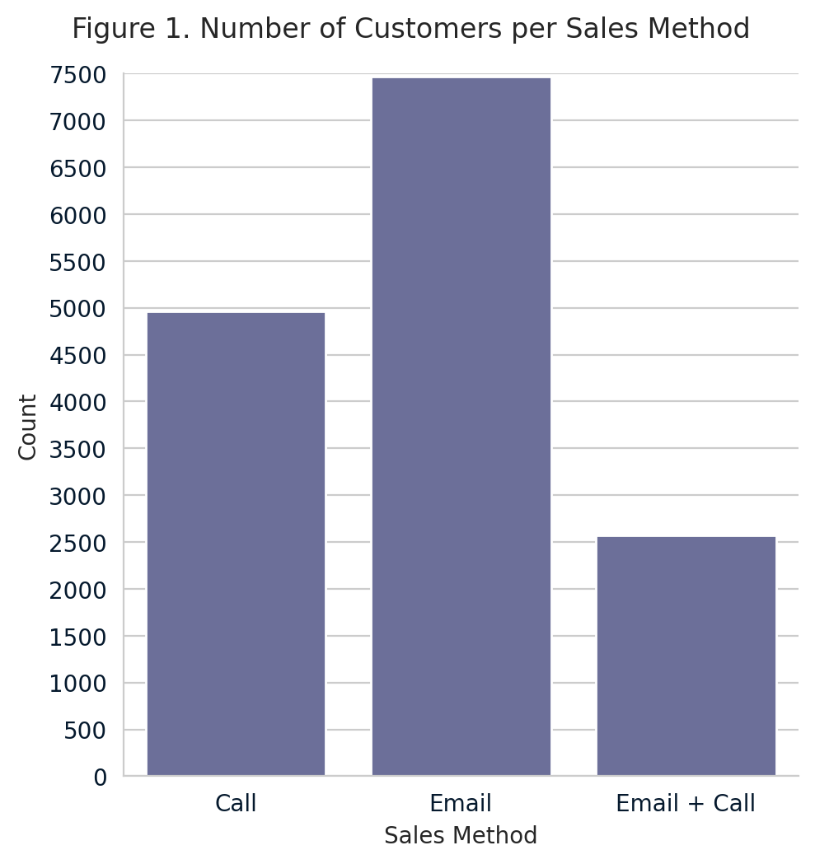
Overview of Sales Method
Emails were the modal approach to generating revenue, accounting for almost 50% of the observations
Emails produced the highest sum of revenue
Notes:
(Click) As you can see, the majority of sales came from the email-only approach. Approximately, 50% (Click)
In turn, the email method also returned the highest total revenue of the 3 methods tested (Click)

Slide 9
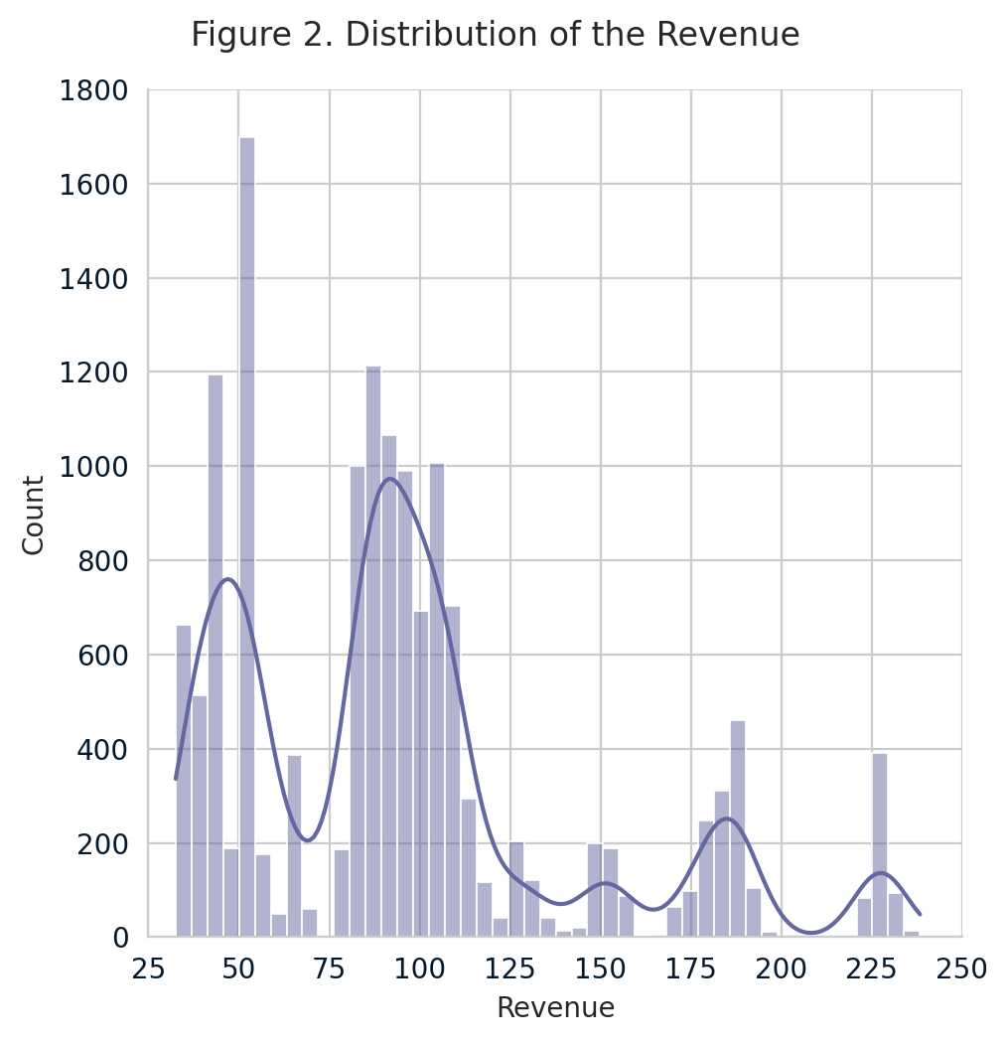
Distribution of Revenue
Revenue was not symmetrical, as it did not follow a normal distribution
The data was skewed to the right
Evidence of 5 tiers of payment, with the modal order of around 100
Notes:
Next, I wanted to see where the revenues fell on linear scale., which I achieved using a histogram.
I saw that there were a lot of big and small orders, but which were the most popular price points? (Click)
As you can see, the data was not normally distributed (Click)
It was skewed to the right (Click)
Where, the KDE line shows that there were 5 brackets (5 humps) that customers opted for, with the most popular spend being somewhere around the 100 mark (Click)

Slide 10
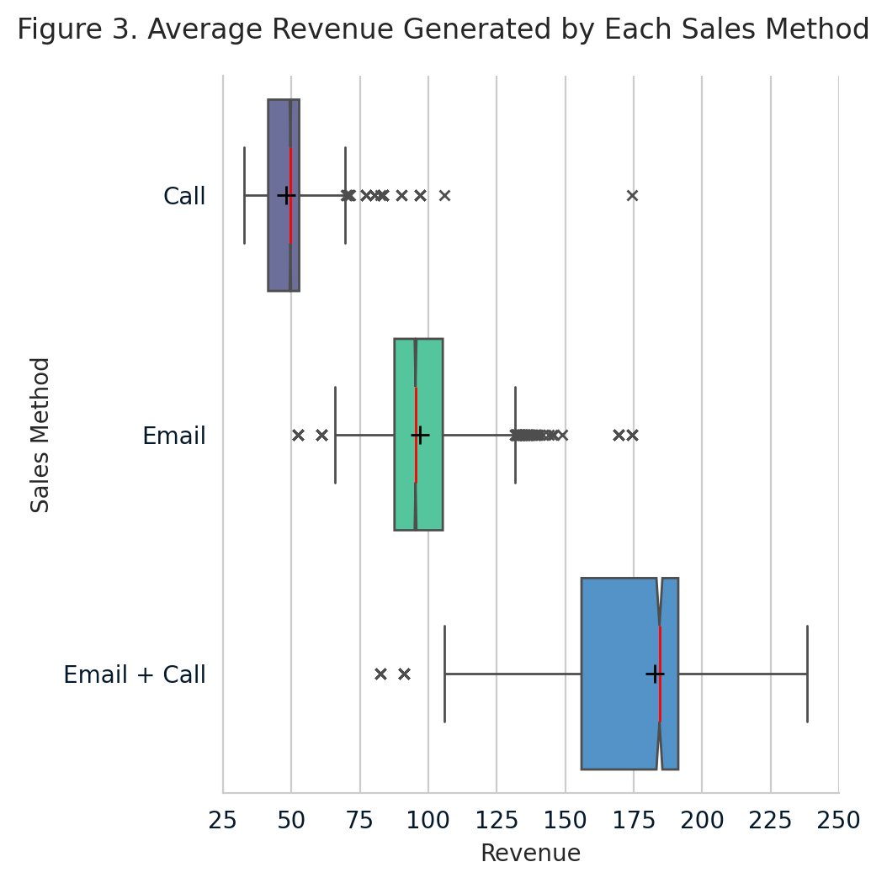
Distribution of Revenue, by Sales Strategy
The combination method saw the most variability, with STD being:
  2.61 times bigger than for emails
  3.23 times larger than for calls
Additionally, the combination method experienced the highest average revenue per order, showing means that were:
  1.89 times greater than emails
  3.79 times more appreciable than calls
True medians for each strategy were, statistically, different
Data skew was minimized by grouping revenue by method
Notes:
I then further broke down the distribution by sales method, using boxplots (Click)
Where you can see that the combination method encompassed the greatest range of the strategies tested (Click x2)
But the email + call method also delivered the highest average revenue per order, shown by the black pluses inside the IQR (boxes) (Click x2)
I also added notches to the boxplots to see if they were statistically similar. Which they weren’t, meaning that the results obtained from each approach were independent from one another (Click)
By grouping, I also minimized the skew that we saw earlier in the histogram. Producing mean and median values that were similar, and more representative of their features (Click)

Slide 11
Time-Series Analysis
Notes:
Next, I wanted to see what changes occurred going from week to week (Click)

Slide 12
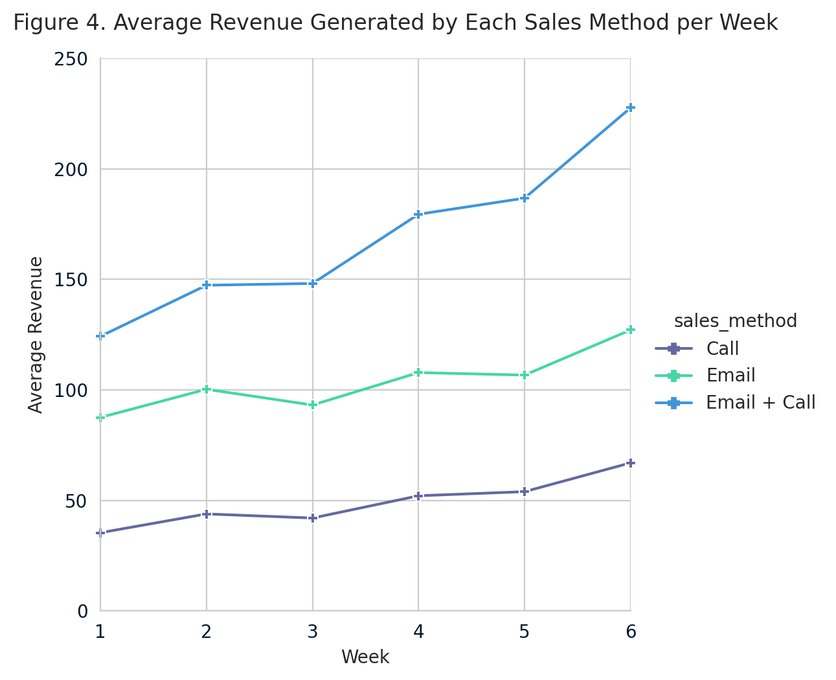
Performance of Methods over time
The absolute differences in sales methods were:
Combination: 103.38 (83.2%)
Emails: 39.58 (45.2%)
Calls: 31.61 (89.3%)
Notes:
Where, all three methods increased from week 1 to 6 (Click)
With the combination method experiencing the greatest absolute difference between its initial and final value (Click)
Although the call method’s line appears relatively flat, it did show the most growth by percentage (Click)

Slide 13
Conclusion
Notes:
Following these findings, I felt confident that I could make recommendations to Pens and Printers about their sales approaches, from this sales period
Let’s start by introducing two business metrics (Click)

Slide 14
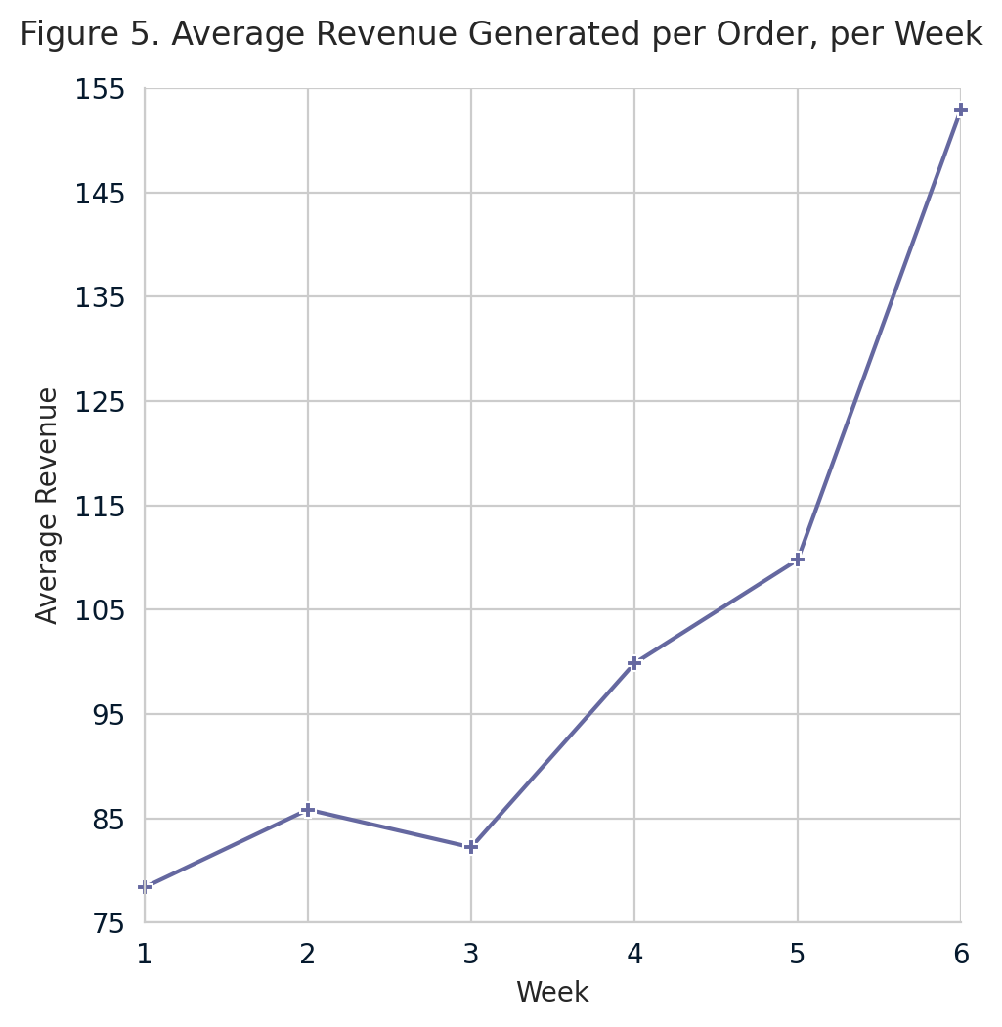
Business Metric #1
Average revenue per sale
Where, following the 6-week testing window, the target metric to beat was 152.91
Notes:
Like the previous figure, I feel that it would be beneficial to track the weekly average revenue of orders. (Click)
As it would provide insight into the efficiency of number of units sold and time spent on customers (Click)
Currently, the target measure to beat is roughly 153 revenue per order (Click)

Slide 15
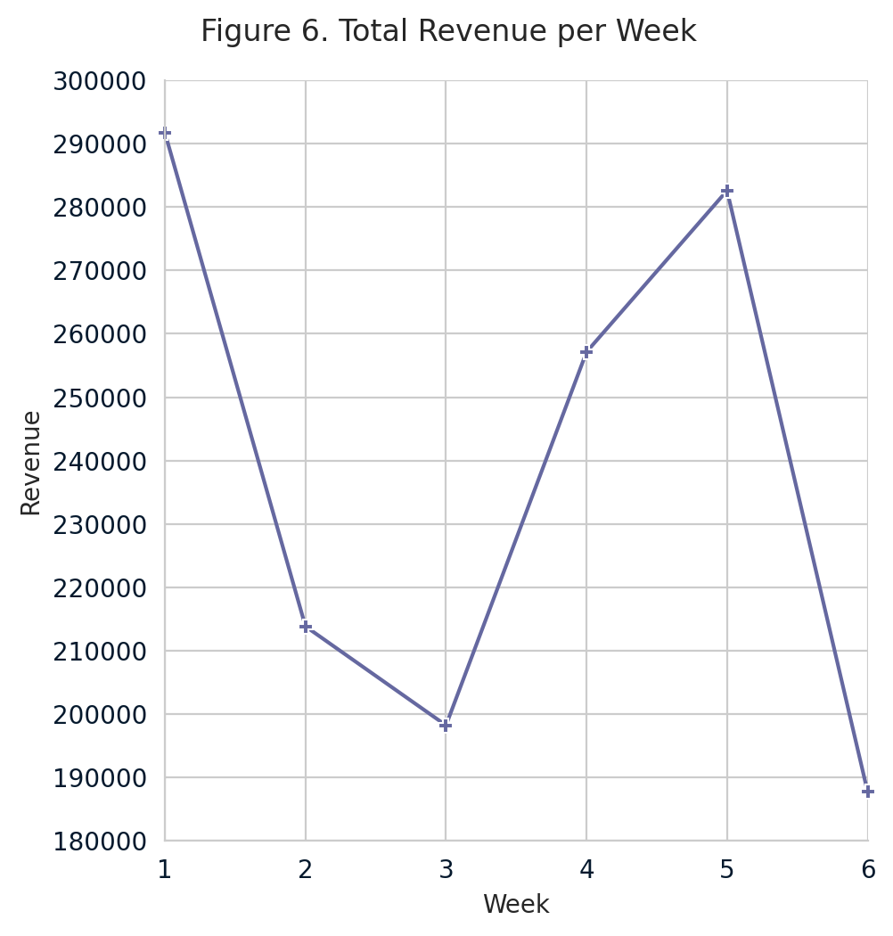
Business Metric #2
Total revenue per week
After the initial 6-week programme, the target metric to beat was 187775.38
Notes:
(Click) The 2nd business metric to track would be the weekly revenue generated by the new product line (Click)
Which, at the present, stands at approximately 190,000 revenue per week (Click)

Slide 16
Recommendations
Reduce the number of cold calls
Increase the number of email & call method attempts
Manage the performance of sales by tracking:
  weekly revenue
  average revenue per order
A continuation study to quantify the success rate
Notes:
To close this presentation out, my recommendations to the business are to:
(Click x6)
I hope you found this presentation insightful and gained a better understanding of the story each sales method told. A full written report has also been produced, delving deeper into each consideration taken.
Have a blessed day (Click)

